Slide 1

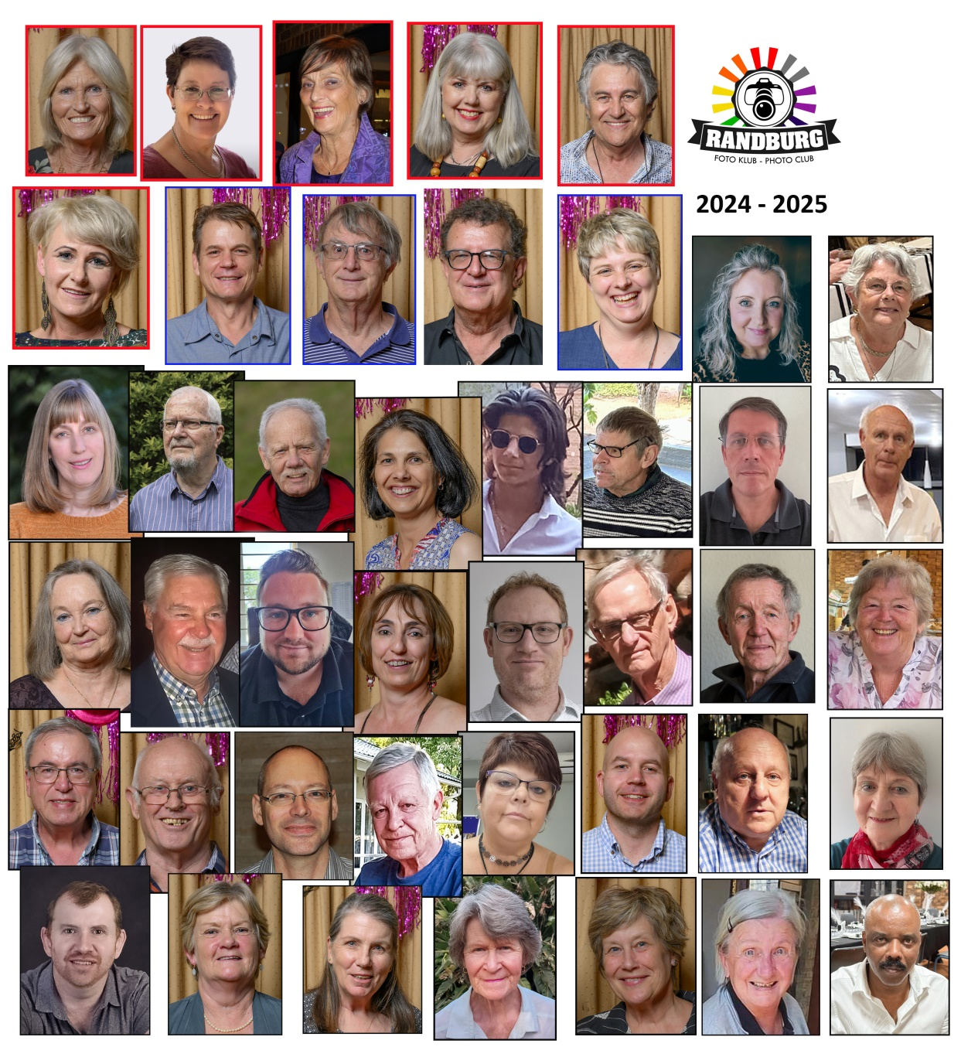
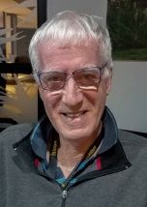
RANDBURG PHOTO CLUB
NEWSLETTER AUGUST 2025

Slide 2
COMMITTEE MEMBERS
2024-2025
Portfolio | Name | Email | Cell Number
Chairman | Mike Brien | mike.brien@telkomsa.net | 0836788885
Treasurer & Membership | Pieter Gravett | pieter@oppienet.co.za | 0824468809
Events / Outings / Functions | Muriel Joubert | shelmondi@tiscali.co.za | O828889674
Monthly Master Class | Chris Joubert | wirecon@icon.co.za | O829078888
Photo Vault Master | Ursula Baumann | ursula@cycling-sa.co.za | O823371591
Judging Co-Ordinator | Coreen Cowper | Ccowper2@gmai.com | 0832923396
The club’s Annual General Meet was held and Minutes of that meeting will be sent via email.

Slide 3
PROMOTIONS
Sue Oertli - 3 star
CONGRATULATIONS!!!

Slide 4
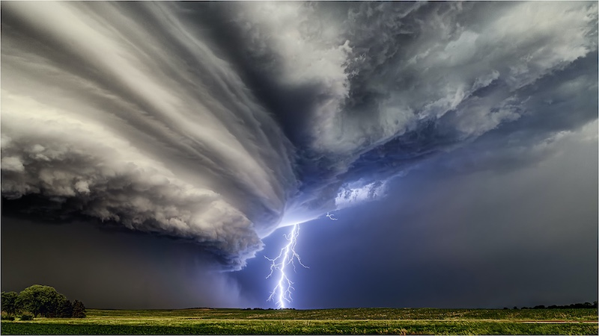
BRAG TIME
Breath of a Supercell
PSSA WEBSITE COMPETITION WINNER JULY 2025
Full details of the difficulty in capturing this amazing image can be found on the PSSA website.
CONGRATULATIONS!
We are so proud of you.

Slide 5
UPCOMING SALONS - CLOSING DATES
2025-08-09 - 28th PSSA Up and Coming National Salon
2025-08-16 - Sandton 10th National Digital Salon
2025-08-09 - Durban Camera Club
2025-09-06 - 6th PSSA Youth National Salon

Slide 6
SALON RESULTS
7Th National Up and Coming Photographic Competition
Sue Oertli - Acceptances 7
Keegan Boland - Acceptance 1
Pierre van Heerden - Acceptance 1
Marina Rutter - Acceptance 1
SSCC 8th National PDI Salon
Marleen Rood - Acceptances 2
3rd Kriel Foto Club Salon
Marleen Rood - Acceptances 2
5th Witzenberg Photographic Society 2025
Ursula Baumann - Acceptances 3
- COM 1
Craig Morgan - Acceptances 3
- PSSA Silver Medal

Slide 7
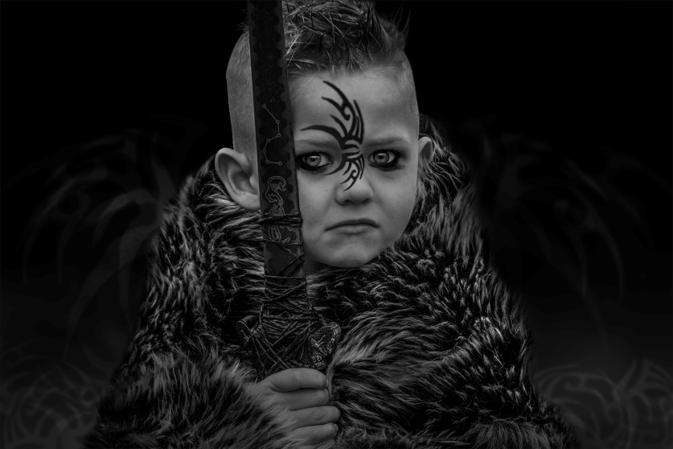
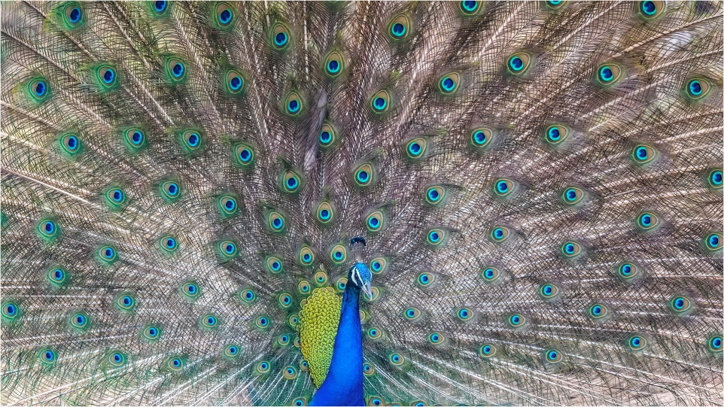

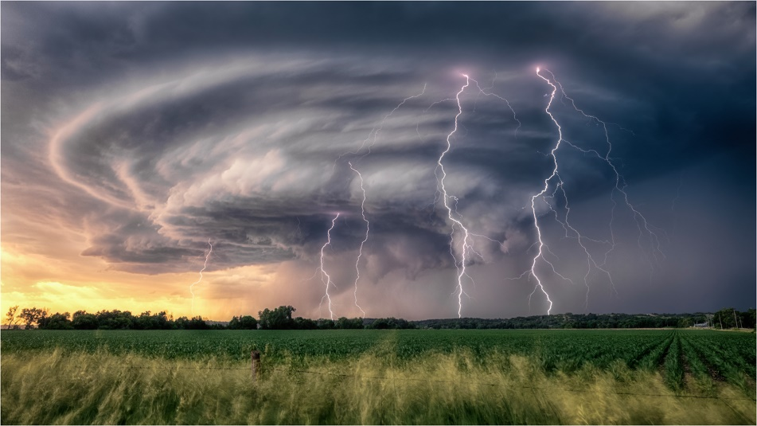
CONGRATULATIONS
CONGRATULATIONS
OUR AUGUST CATEGORY WINNERS
OUR AUGUST CATEGORY WINNERS
Winner – Wildlife/Nature
Craig Morgan -
The Grand Display
Winner – Monochrome
Ursula Baumann –
Small bravery before the big fight
Winner – Open
Craig Morgan-Storm Sentinel
Winner – Set Subject
Jessie Brien- Mirrored Pattern

Slide 8
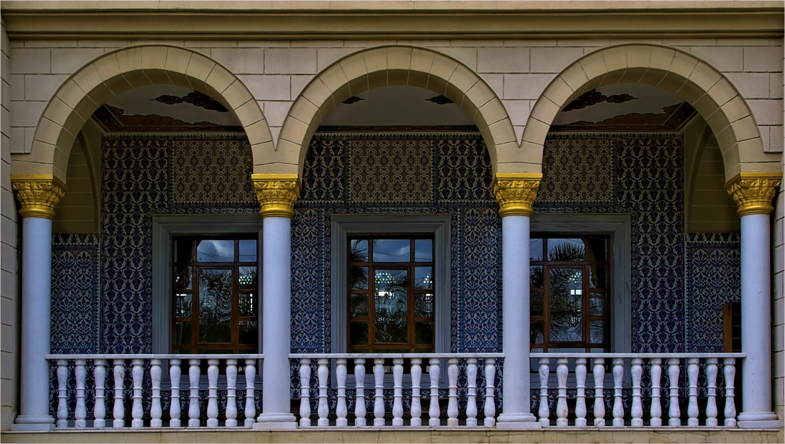

JUNIOR WINNER
SENIOR WINNER
Jan van Heerden
Symmetry
Ursula Baumann
Small bravery before the big fight

Slide 9
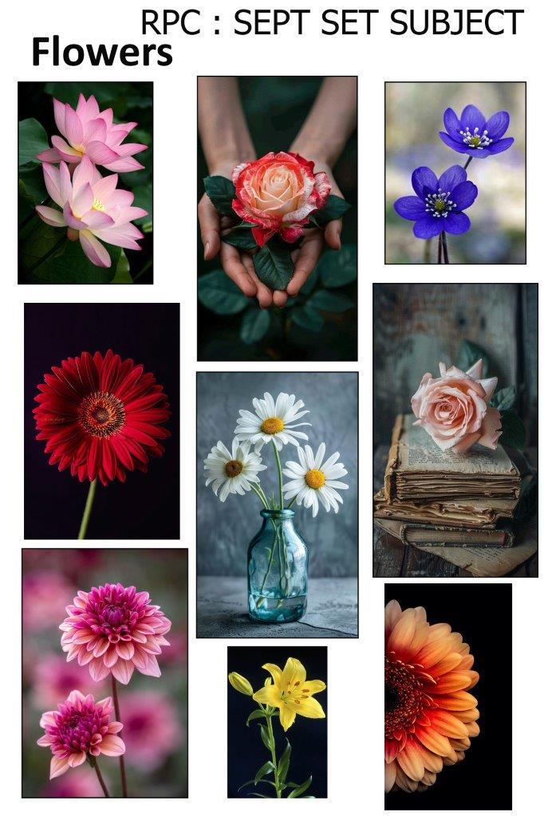

Slide 10

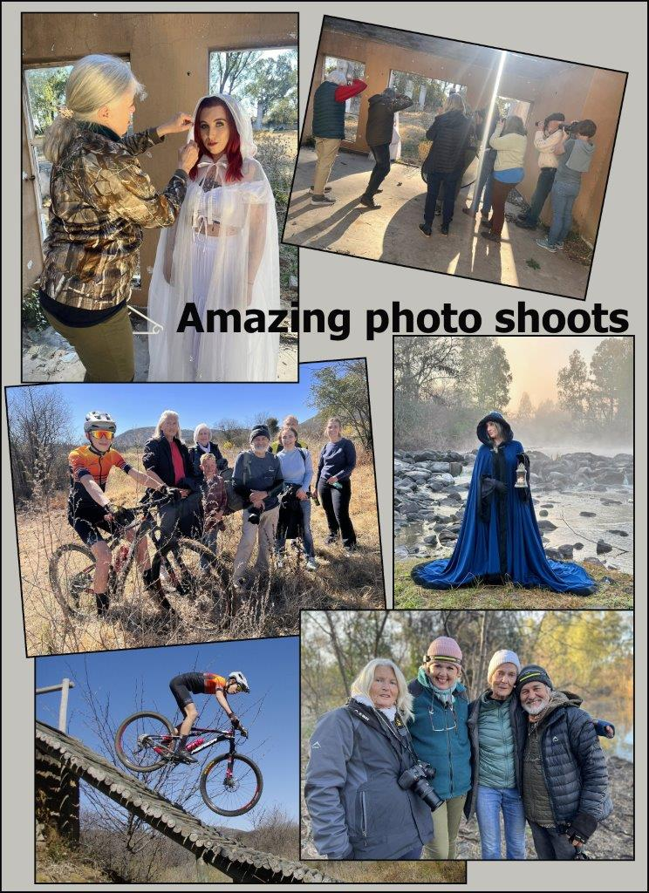
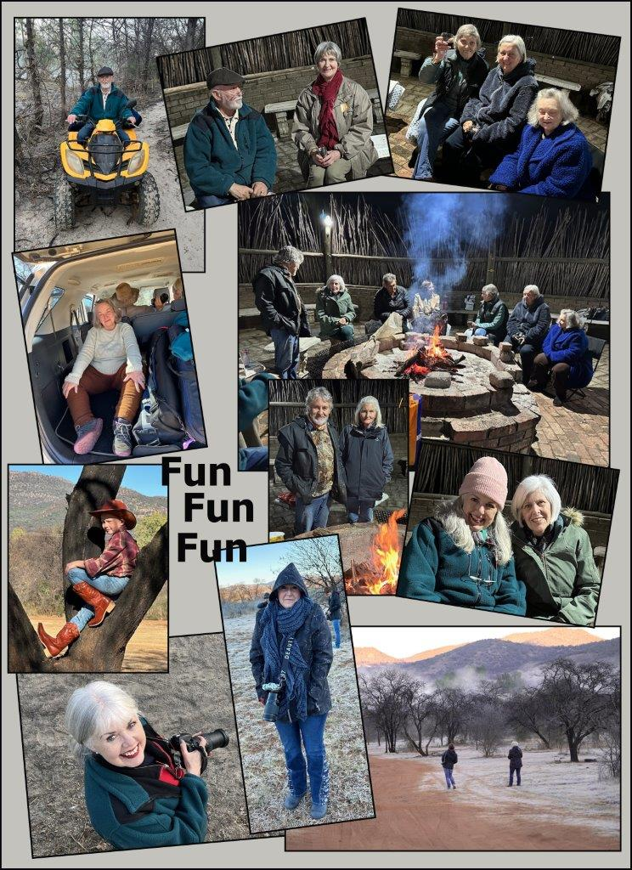
OUTINGS

Slide 11
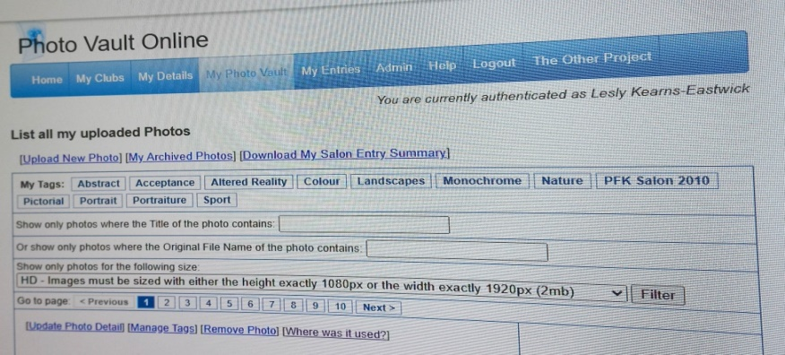
INSTRUCTION FOR ALL SALON ENTRIES OBTAINABLE VIA PHOTOVAULT
Please note that once Ursula (our Photovault Master) has registered any member onto the system the control etc. reverts to the member.
Please also note that the Photovault master is unable to change any forgotten passwords
To assist with the retrieval of the required information the following guidelines will assist:
You are able to track your salon entries by clicking on My Photo Vault which will reflect the following headings:
Upload new photo
My archived photos
DOWNLOAD MY SALON SUMMARY
Click on the above heading and download the excel spreadsheet which will reflect all your salon entries whether accepted or not.
If you click on the heading “Where was it used?” which is available on the panel alongside your uploaded image you will establish exactly when and where your photo was loaded and the results obtained e.g. Gold, COM, acceptance etc.
Of further explanation is that you should receive individual emails with results of your entries to a particular salon and it is suggested that you also place those results in a separate folder for ease of reference offline.
As salon results are published the chairman ascertains which club members have achieved medals, Coms or acceptances and these are reflected initially in the club night presentation and thereafter in the newsletter. Should the information be incorrect in any way please contact the chairman directly.

Slide 12
RANDBURG PHOTO CLUB
CALENDAR
11 – 15th National PSSA Congress in Struisbaai
21st Club Discussion Evening
SEPT 2025 4th Monthly Club Evening
Set Subject : Flowers
13th Southern Gauteng Regional Congress
18th Club Discussion Evening
OCT 2025 2nd Monthly Club Evening
Set Subject : Urban Reflections
16th Club Discussion Evening
18th CERPS regional congress at
St Dominics School in Boksburg
NOV 2025 6th Monthly Club Meeting
Set Subject : Webbed Feet
20th Club Discussion Evening
DEC 2025 4th ANNUAL AWARDS EVENING

